Slide 1
OVI-719
CHRISTOPHE@OVIE.TX.COM
Transforming outcomes for patients with glioblastoma.
Development of OVI-719, an oncolytic virus engineered for GBM therapy.

Slide 2
OVI-719
CHRISTOPHE@OVIE.TX.COM
Oncolytic viruses
Patients’ outcome remain poor.
A hope for Effective Treatment of GBM.
Aggressive brain tumor with near always fatal outcome: mOS 16 months, 6% OS at 7 year¹
Highly invasive but generally confined to the brain.
Two oncolytic viruses with therapeutic benefit.
HSV based oncoytic viruses (oHSV)
Daiichi Sankyo’s Delytact conditionally approved in Japan based on 84% one-year survival rate²
CAN-3110 (rQ-Nestin34.5) mOS 14.2 mo vs. 7.9 in HSV-1 seropositive rGBM^{3\}

Slide 3
OVI-719
CHRISTOPHE@OVIE.TX.COM
OVI-719
A Next-Gen oHSV.
 | Ovi-719 | Can-3110 | Delytact
Tumor replication | ICP34.5 WT Fusogenic mutation | Nestin-ICP34.5 WT | ICP34.5 deletion
Entry receptor | EGFR, EGFRvIII, Nectin-1 | Nectin-1, HVEM, heparan sulfate | Nectin-1, HVEM, heparan sulfate
Safety | microRNA attenuation, axonal transport deficient | Nestin controlled | ICP34.5 deletion
Immune Stimulatory Transgenes | IL-12, aPD-1 nAb, aTREM2 scAb, HPGD | None | None
Stage | 2yrs to IND | Phase 1 | Cond. approved in Japan

Slide 4
OVI-719
CHRISTOPHE@OVIE.TX.COM
Ovie Tx Goal
Evaluate the potential of OV-719 in GBM.
Designed by oHSV experts at Oncorus, Inc.
OVI-719 (formerly known as ONCR-719) has been developed preclinically in collaboration with Pr. Francisco Quintana.
Ovie Tx is licensing the IP to enable the development of OVI-719 for glioblastoma.

Slide 5
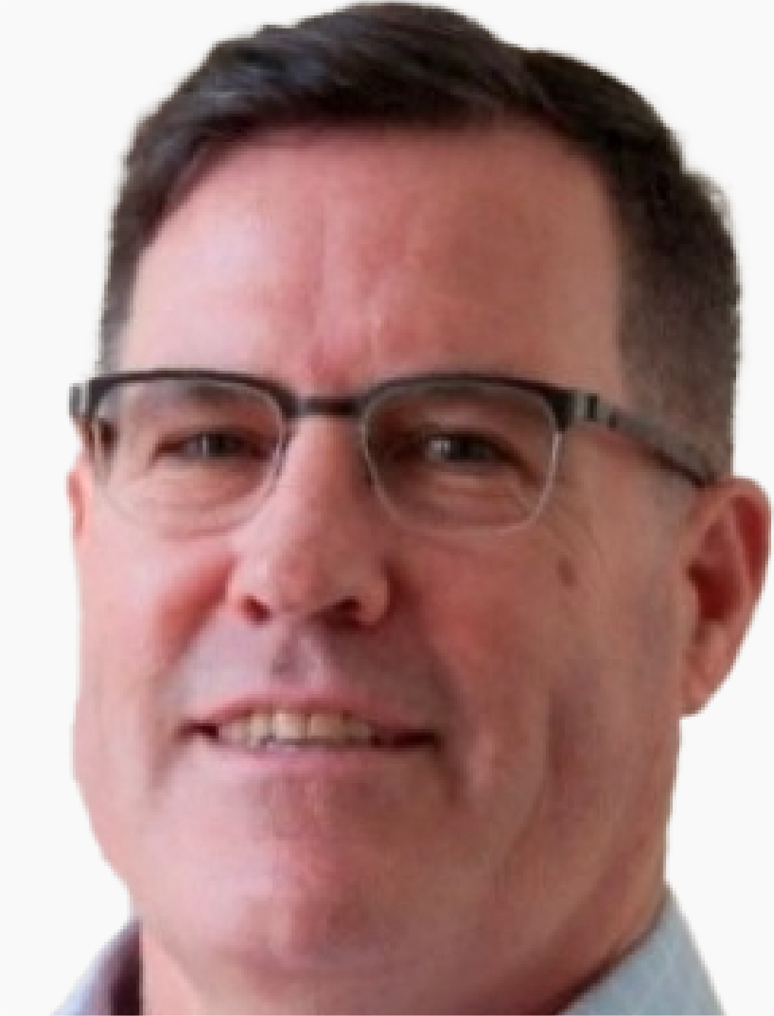
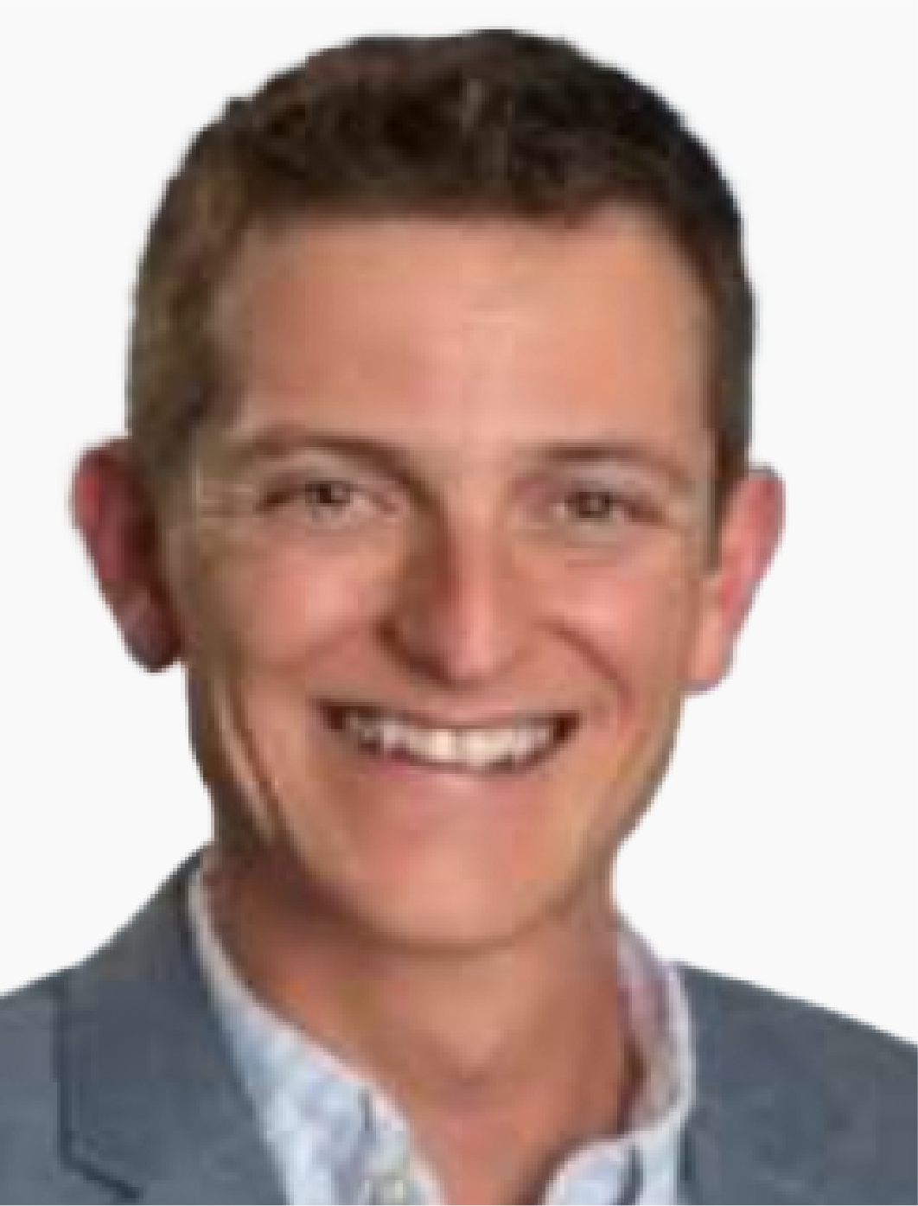
OVI-719
CHRISTOPHE@OVIE.TX.COM
Experienced founder team.
CEO
Stephanie
Duncanson, PhD
Christophe
Quéva, PhD
CBO
Craig
Straphdee, PhD
CSO
Francisco
Quintana, PhD
Scientific Advisor
Professor of Neurology, Department of Neurology, Brigham and Women’s Hospital, Harvard Medical School

Slide 6
OVI-719
CHRISTOPHE@OVIE.TX.COM
Engineering Strategy
Potent infection, spread, and oncolysis
Unique, replication competent HSV strain selected for oncolysis.
Infect through EGFR/EGFRvIII, highly expressed in GBM.
Fusogenic mutations to enhance viral spread.
Expressly Designed for Optimal Therapeutic Benefit for GBM.
Clinically validated safety strategy
Protection of healthy brain tissue by genetically engineered microRNA dependent off-switches.
Mutations to prevent HSV transport within neurons.
Transgenes selected to fight immune suppression in GBM
Longer survival vs. unarmed oHSV in preclinical models.
Optimized for high transgene expression.

Slide 7
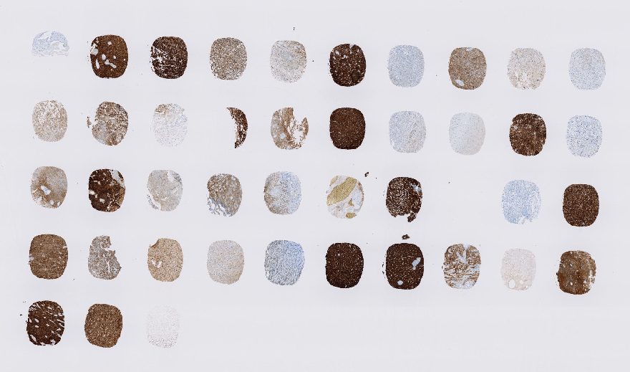
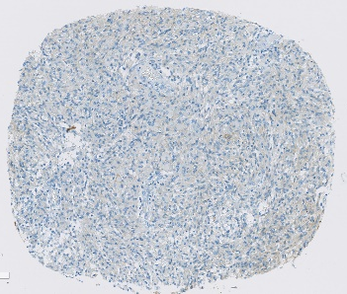
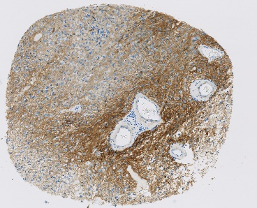
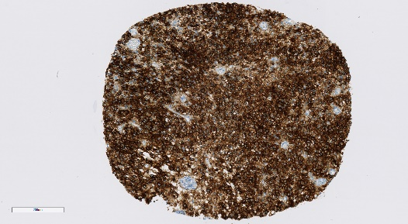
OVI-719
CHRISTOPHE@OVIE.TX.COM
Retargeted to Epidermal Growth Factor Receptor
GBM express high levels of EGFR/EGFRVIII.
0.1% EGFR+ H-Sc ore: 0.17
74% EGFR+ H-Score: 143
99% EGFR+ H-Score: 293
N= 41 including 1 IDHmut, primary GBM IV, 5 recurrent
35 of 41 (85.3%) human GBM cores express EGFR/EGFRvIII.
Only 1 of 41 express HSV receptor Nectin-1.

Slide 8
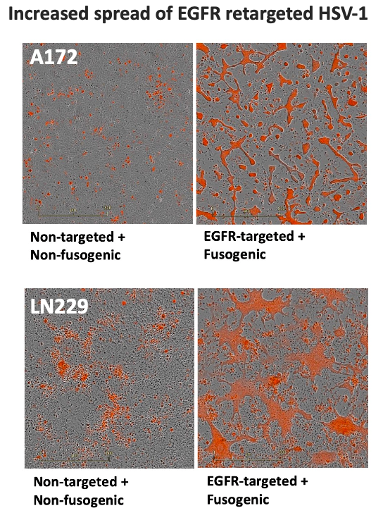
OVI-719
CHRISTOPHE@OVIE.TX.COM
Fusogenic Mutations to Increase Viral Spread
Increased spread of EGFR retargeted HSV-1.
Giovannoni et al submitted

Slide 9
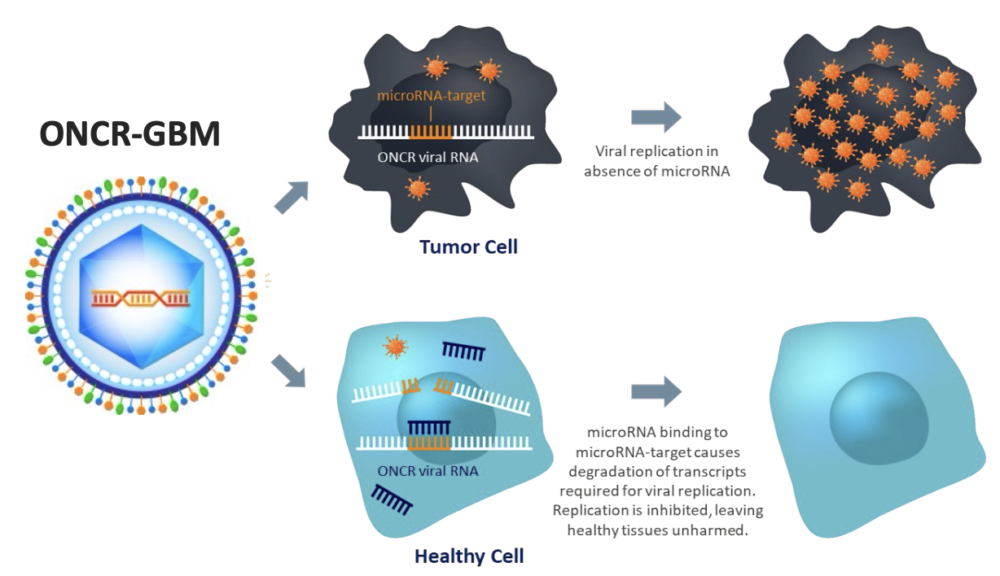
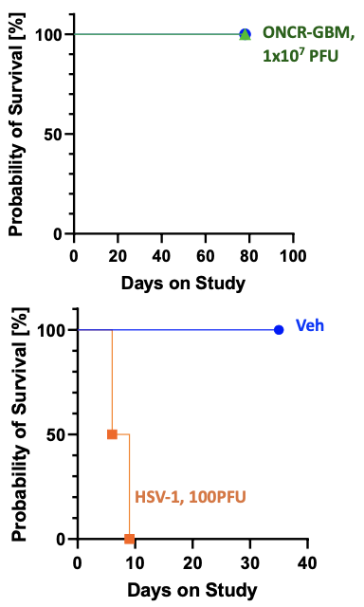
OVI-719
CHRISTOPHE@OVIE.TX.COM
Safety Strategy
Clinically Validated Off-switch Present Only in Healthy Cells.
Intercranial injection in HSV-sensitive mouse strain: >10,000-Fold safety window.
MicroRNA switches drives selective replication in cancer cells.

Slide 10
OVI-719
CHRISTOPHE@OVIE.TX.COM
Immune Priming
T-cells.
IL-12: Promotes recruitment and activity of cytotoxic T and NK cells in tumor.
Anti-PD-1 Nanobody: Inhibits immune checkpoint activation and T cell exhaustion.
Four Payloads to overcome the Potent Immune Suppression that is a Hallmark of GBM.
Immunosuppressive Macrophages.
HPGD: Degrades PGE2 to promote DC priming and sensitization to immune therapy1; may inhibit glioma cell proliferation, angiogenesis and limit need for steroids.
Fc-Enhanced TREM-2 mAb: Inhibits immunosuppressive activity of tumor associated macrophages and increases sensitivity to anti- PD-1.

Slide 11
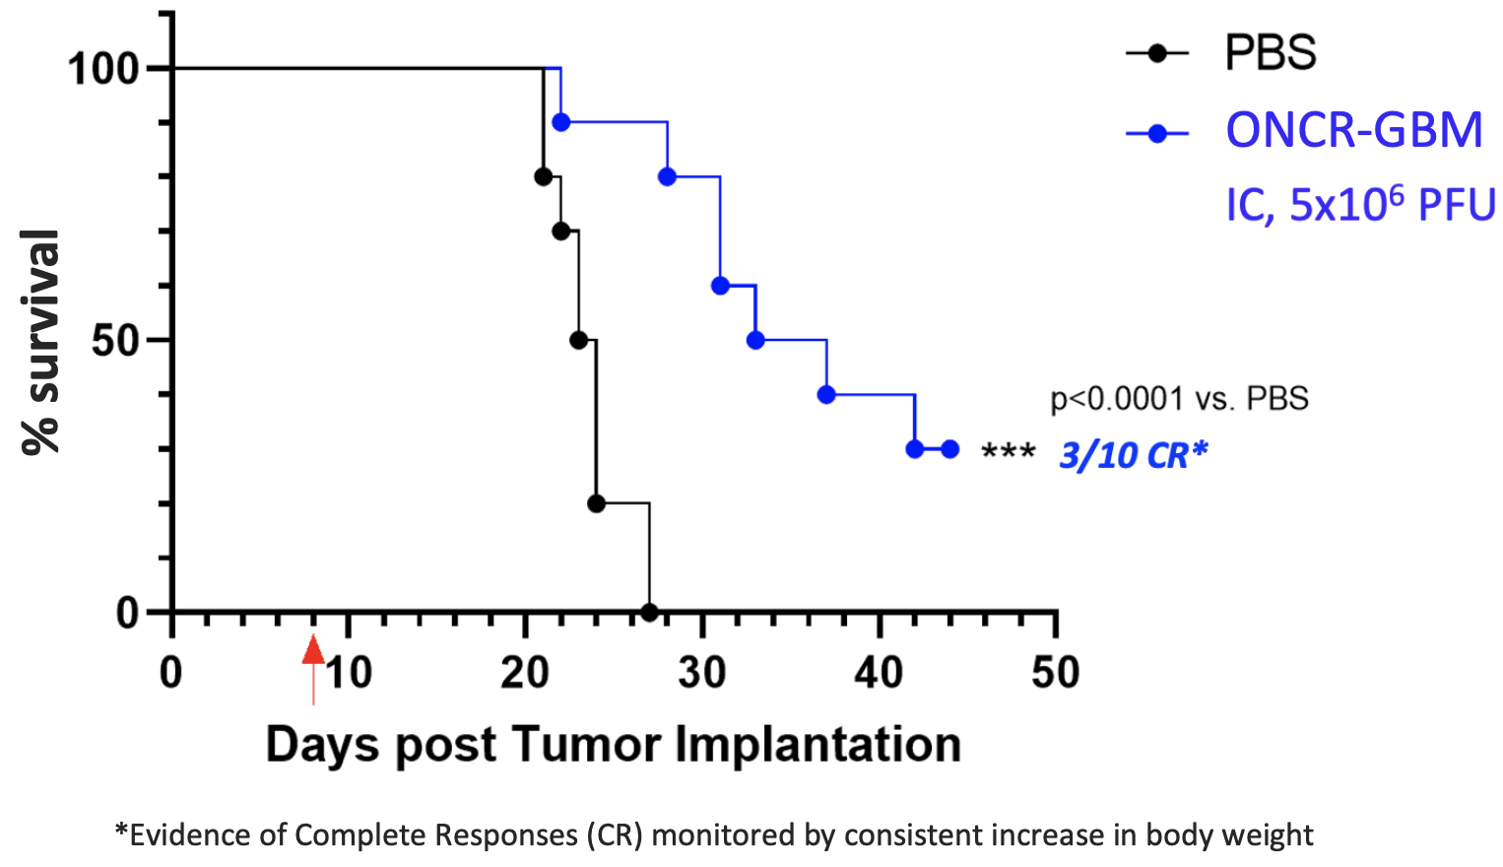
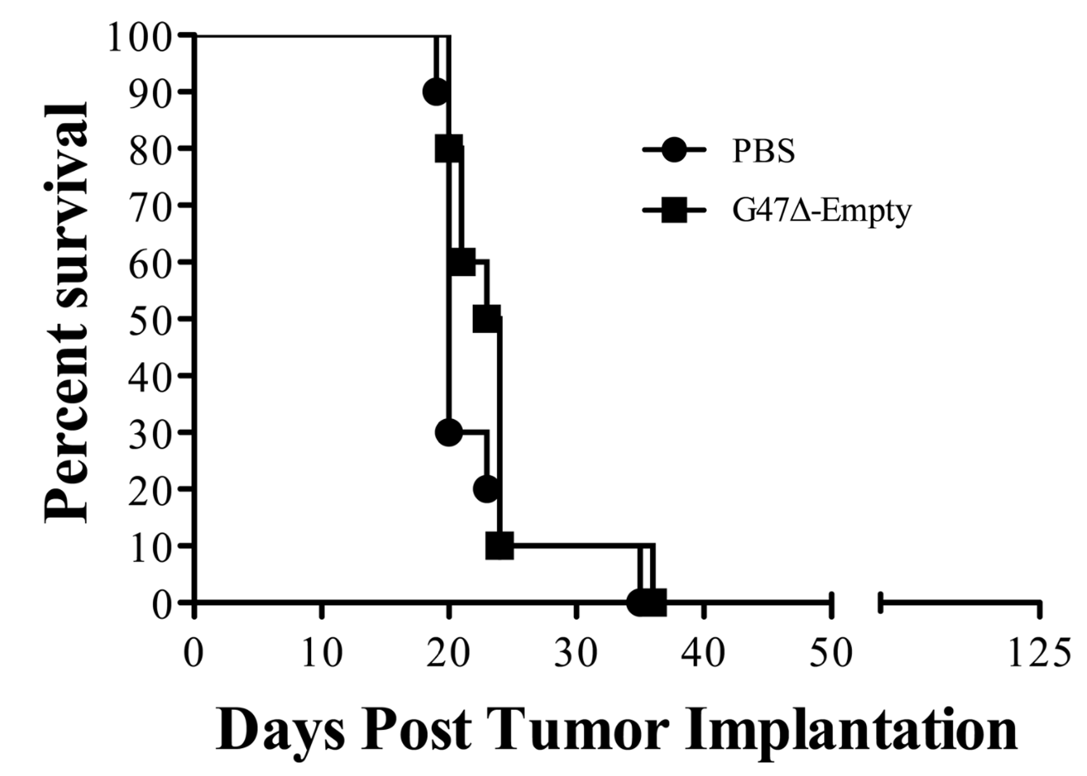
OVI-719
CHRISTOPHE@OVIE.TX.COM
Improved Survival
Superior Efficacy vs. Delytact in GBM model.
Giovannoni et al submitted
Barnard et al., Neurosurgery. 2012.
Saha et al., Cancer Cell 2017
Jackson et al., Molecular Therapy Oncolytics 2021
OVI-719: egfr-targeted hsv-1 armed with il-12, apd-1, hpgd & aTREM2.
G47∆ (delytact) & can-3110 have no complete responses in ct2a-n model.^{1,2}

Slide 12
OVI-719
CHRISTOPHE@OVIE.TX.COM
Path to IND
Drug Candidate to IND path defined.
Based on Previous Extensive Regulatory Interactions.
Regulatory feedback obtained during the development of ex-Oncorus assets (2 PIND and IND between 2017-2021).
FDA agreement to use surrogate virus encoding mouse transgenes.
IND enabling studies.
Single IC injection in HSV sensitive Balb/c mice (GLP).
Single IT injection in orthotopically implanted GBM tumor model (near GLP).
Endpoints (clinical observation, chemistry, hematology, pathology, virus biodistribution, transgene plasma concentration).

Slide 13
OVI-719
CHRISTOPHE@OVIE.TX.COM
OVI-719 IND within two years.
Q1 | Q2 | Q3 | Q4 | Q5 | Q6 | Q7 | Q8
Virus recovery & characterization
Non-GLP Toxicology intracranial GL-261
Analytical assay devt
DRF, BioD
GLP Toxicology intracranial Balb/c
Non-GLP Production
MVB PSS
MVB Prod & Release
Drug Product cGMP Manf. & Release
Analytical methods devt
Process Devt
Tech Transfer & ENG Runs
Budget
PIND Meeting Readiness
IND Readiness
Site Selection; Protocol Synopsis
Clinical Trial Readiness
Research
DP Disposition & 1mth Stability
Preclinical
MVB Release
GLP Tox Study Report
CMC
PIND Meeting
IND
filed
GMP Process Lock
GMP Start
Regulatory
Clinical
Budget to IND ~$16M.

Slide 14
OVI-719
CHRISTOPHE@OVIE.TX.COM
Ovie TX
Ovie TX: transforming outcomes for GBM patients.
Best in Class oHSV engineered for the treatment of GBM.
2 Years to the clinic.
Experienced leadership team.
Expertise in HSV engineering, manufacturing, regulatory, safety.

Slide 15
OVI-719
CHRISTOPHE@OVIE.TX.COM

